Slide 1
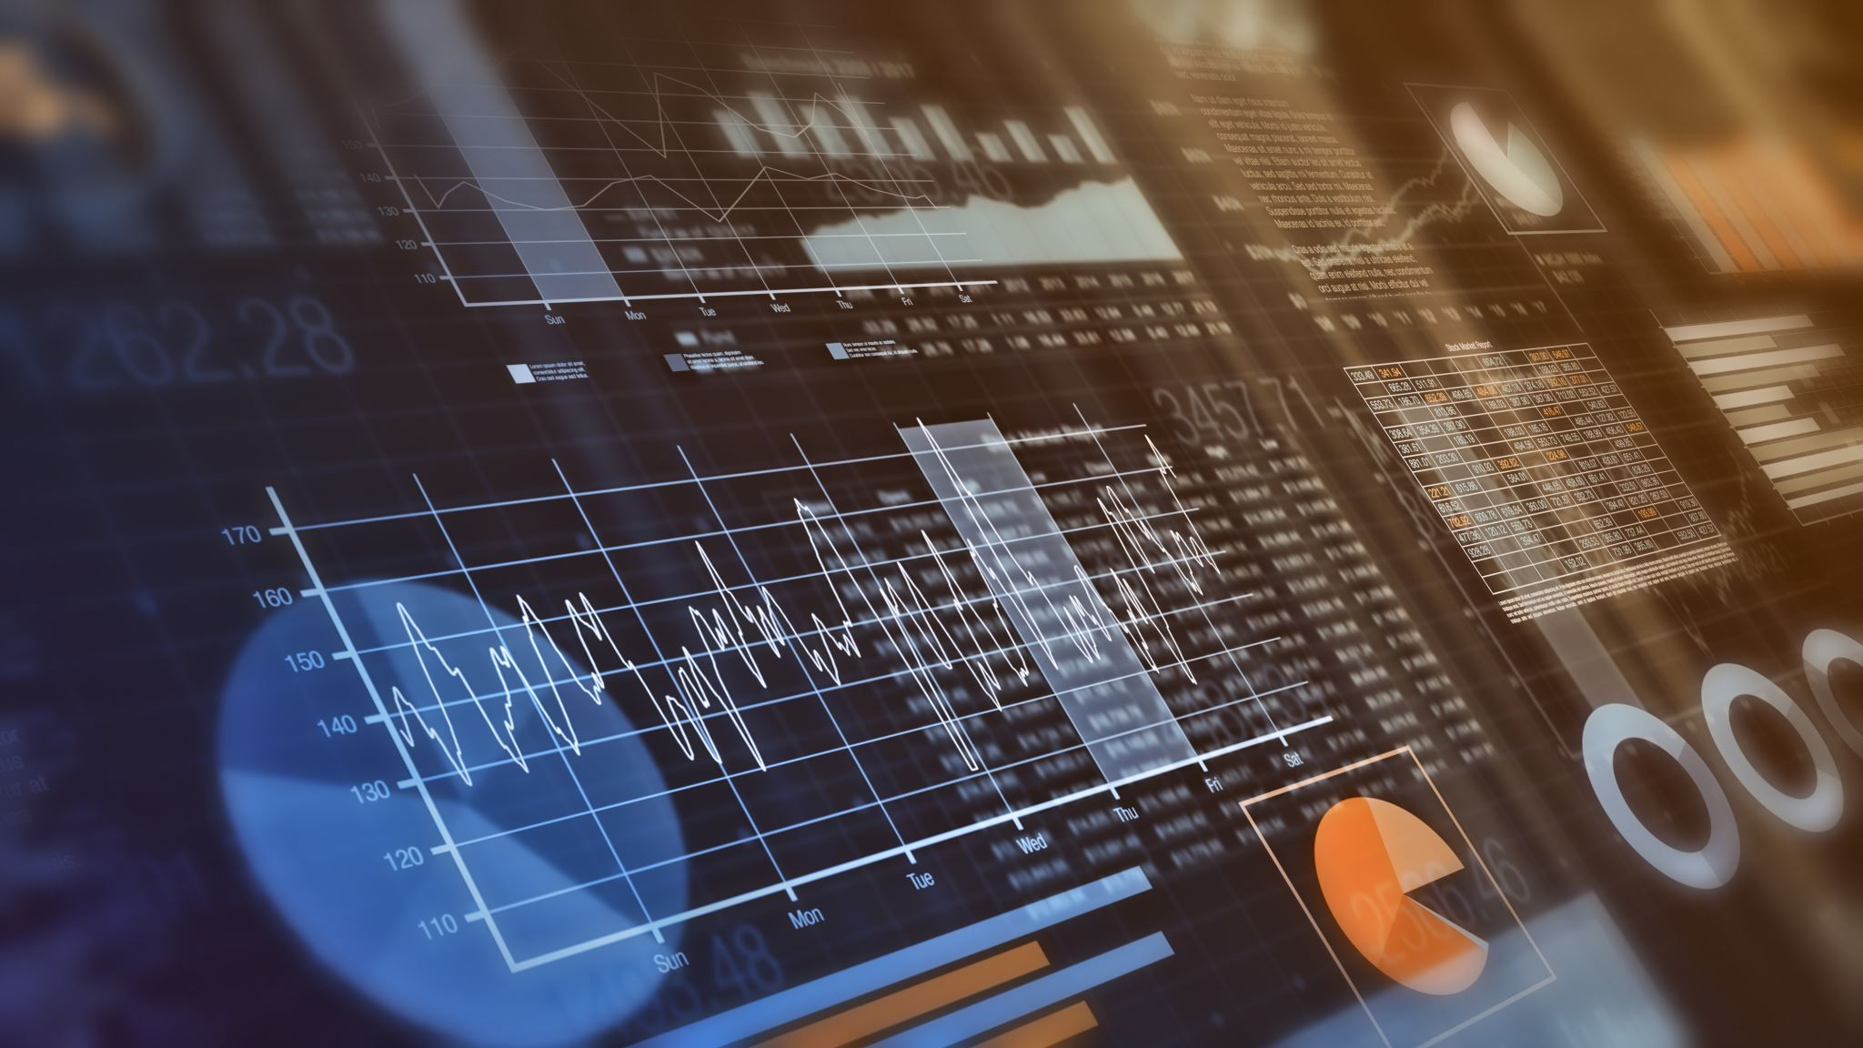
Introduction to Business Analytics
Nikhil Narayane
4th year Ph.D. Candidate
Department of Business Analytics & Statistics
Haslam College of Business
University of Tennessee, Knoxville

Slide 2
Index
Introduction to Business Analytics
Definition of Business Analytics
Introduction and Basic Concepts
Hands-On Demonstration: Predicting Health Insurance Charges
Predictive Analytics
Descriptive Analytics
Introduction and Basic Concepts
Hands-On Demonstration: Predicting Health Insurance Charges
Conclusion
Real-Life Applications in Industry
Future of Business Analytics Today
Questions & Discussions
Future of Business Analytics

Slide 3
Introduction to Business Analytics

Slide 4
What is Business Analytics
“Using Analytics to improve Business”
Notes:
This process is not unique to business , It has been used in many other fields.
If we could predict the outcomes for unknown situations, we could tap potential markets and inmprove operation
Preparing for an event that has not happeed can help us tap potential markets.
This is where predictive analytics helps us.
https://online.hbs.edu/blog/post/predictive-analytics
https://www.retailbankerinternational.com/news/cba-fraud-speeds-ai/?cf-view
Redue the text content on the slide, because studens might read it and will not pay attention, Use slides as reminder to what you want to say

Slide 5
What is Business Analytics
“Using Analytics to improve Business”
What to analyze?
How to analyze?
What do you get?
Notes:
This process is not unique to business , It has been used in many other fields.
If we could predict the outcomes for unknown situations, we could tap potential markets and inmprove operation
Preparing for an event that has not happeed can help us tap potential markets.
This is where predictive analytics helps us.
https://online.hbs.edu/blog/post/predictive-analytics
https://www.retailbankerinternational.com/news/cba-fraud-speeds-ai/?cf-view
Redue the text content on the slide, because studens might read it and will not pay attention, Use slides as reminder to what you want to say

Slide 6
What is Business Analytics
“Using Analytics to improve Business”
What to analyze?
How to analyze?
What do you get?
Fact-Based
Business Insights
Historical Data
Tools such as Statistics,
Machine Learning, AI, Optimization
Business Analytics (BA) is a comprehensive process that uses historical data and applies techniques like statistics, machine learning, AI, and optimization to generate insights and drive business decisions.
Notes:
This process is not unique to business , It has been used in many other fields.
If we could predict the outcomes for unknown situations, we could tap potential markets and inmprove operation
Preparing for an event that has not happeed can help us tap potential markets.
This is where predictive analytics helps us.
https://online.hbs.edu/blog/post/predictive-analytics
https://www.retailbankerinternational.com/news/cba-fraud-speeds-ai/?cf-view
Redue the text content on the slide, because studens might read it and will not pay attention, Use slides as reminder to what you want to say

Slide 7


Diverse Applications of Business Analytics
Netflix: Personalized Recommendations
Revenue: 151 million subscribers, $33 billion revenue (2024)
Data: User’s Age, Feedback — Likes/Dislikes)
Analytics Approach: Recommendation System
80% of content streamed is from recommendations
Cost Savings: High retention minimizes advertising costs by accurately predicting audience preferences
Ford Motor : Predictive Maintenance
Revenue: $176.19 bn (2023)
Data: Real-time performance monitoring
Analytics Approach: Predictive Maintenance
Predicts potential failures before they occurred
Increased operational efficiency and minimized disruptions in the manufacturing process
Cost Savings: Avoided unplanned downtime, saving more than $1 million
Different companies leverage business analytics in various ways to improve their business
Notes:
https://cyberwhale.tech/netflix-big-data/
Tell it as a story rather than
Netflix rec
Achieves a 90% customer retention rate, outperforming Hulu (64%) and Amazon Prime (75%)

Slide 8
Four Types of Analytics
Based on how analytics is applied by organizations, analytics can be classified into:
Descriptive
Data Exploration
E.g. Data Visualization
Predictive
Predicting Future Outcomes
E.g. Linear Regression, Random Forest
Prescriptive
Decisions based on Predictions
E.g. Linear Optimization
Diagnostic
Anomaly Detection
E.g. Outlier Detection
What happened?
Why it happened?
What will happen?
What should we do?
Notes:
If we could predict the outcomes for unknown situations, we could tap potential markets and inmprove operation
Preparing for an event that has not happeed can help us tap potential markets.
This is where predictive analytics helps us.
https://online.hbs.edu/blog/post/predictive-analytics
https://www.retailbankerinternational.com/news/cba-fraud-speeds-ai/?cf-view

Slide 9
Four Types of Analytics
We will focus on the highlighted two
Descriptive
Data Exploration
E.g. Data Visualization
Predictive
Predicting Future Outcomes
E.g. Linear Regression, Random Forest
Prescriptive
Decisions based on Predictions
E.g. Linear Optimization
Diagnostic
Anomaly Detection
E.g. Outlier Detection
Bar Chart,Scatter Plot, Box Plot
What happened?
Why it happened?
What will happen?
What should we do?
Notes:
If we could predict the outcomes for unknown situations, we could tap potential markets and inmprove operation
Preparing for an event that has not happeed can help us tap potential markets.
This is where predictive analytics helps us.
https://online.hbs.edu/blog/post/predictive-analytics
https://www.retailbankerinternational.com/news/cba-fraud-speeds-ai/?cf-view

Slide 10
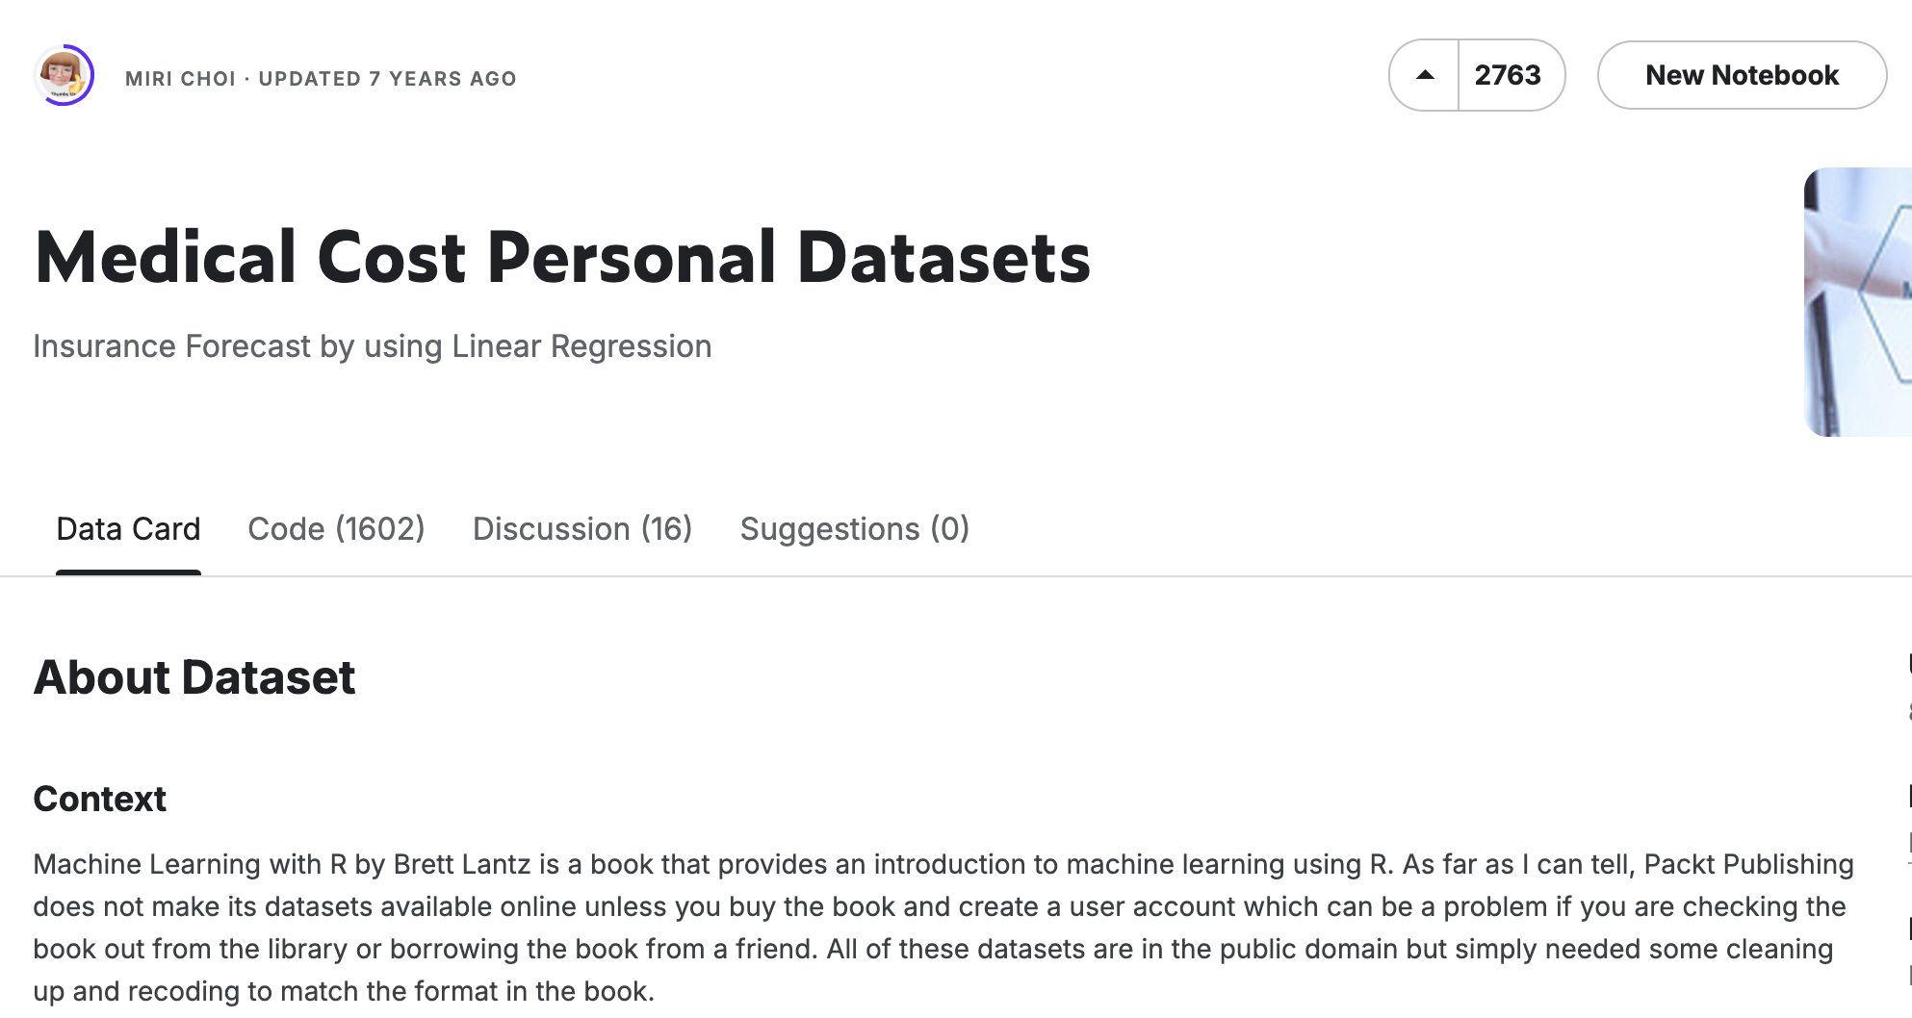
Understanding Analytics Through Project
Teaching by example is not the best way to teach.
It is the only way to teach”
We will be using:
Fictional data of Medical Insurance charges from Kaggle
Python programming language
What factors drive insurance premium in general?
a.
b.
c.
Notes:
Before we start the analysis, imagine if you are the insurance company and you have to set optimal insurance premium for the customer.
What information would you ask your customer to decide his premium?
Age, Sex, Drinking Habits, Smoking Habits, Number of Dependents, Height, Weight, Address by that I mean which region of the city or state, type of coverage

Slide 11
Descriptive Analytics
"Analyzing historical data to understand what has happened."

Slide 12
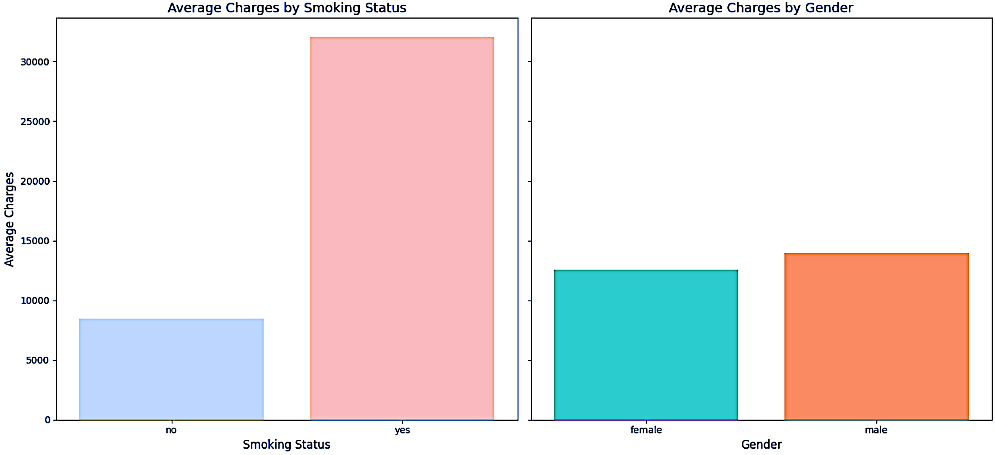
How Different Variables affect Insurance Charges
Does smoking affect insurance premium?
Does gender affect insurance premium?
Notes:
Before we start the analysis, imagine if you are the insurance company and you have to set optimal insurance premium for the customer.
What information would you ask your customer to decide his premium?
Age, Sex, Drinking Habits, Smoking Habits, Number of Dependents, Height, Weight, Address by that I mean which region of the city or state, type of coverage, genetic disorders
These are some good points to consider while determining insurance premium
Now lets look at our dataset.
We will not be discussing the code. The code will be usually provided to the students.
With chatgpt, coding has become very easym but you still need to understand the code so I have written comments whereever necessary.
If you have any questions in coding, please let me know
This jupyter cell will load the dataset in to the memory.
We can see that our dataset has 1338 observations and 7 columns or variables.
You mentioned several factors which could affect insurance premium but in our dataset we don’t have all of them.
This is how it would be in real life working as business analyst because not all the data we need will be given or the companies themselves don’t have it.
This process of data storing and management is called as Data Warehousing. It is a part of business analytics but comes under the branch of business intelligence.
Now assume you were insurance company employees and you had access to this dataset, what kind of descriptive analysis wold you do?
Some would say, does smoking affect insurance premium? Do women pay higher than men?
I would also want to know what is the average insurane premium charged per person?
These are some very interesting analytics, and all of them require use of more than one variable at the same time.
We will see all these analytics if we have time, but lets do some basic ones now.
Let us first answer the question, does smoking affect insurance charges,

Slide 13
How Different Variables affect Insurance Charges
Does smoking affect insurance premium? Definitely , Yes
Does gender affect insurance premium? Can’t say, Difference is too small
Notes:
Before we start the analysis, imagine if you are the insurance company and you have to set optimal insurance premium for the customer.
What information would you ask your customer to decide his premium?
Age, Sex, Drinking Habits, Smoking Habits, Number of Dependents, Height, Weight, Address by that I mean which region of the city or state, type of coverage, genetic disorders
These are some good points to consider while determining insurance premium
Now lets look at our dataset.
We will not be discussing the code. The code will be usually provided to the students.
With chatgpt, coding has become very easym but you still need to understand the code so I have written comments whereever necessary.
If you have any questions in coding, please let me know
This jupyter cell will load the dataset in to the memory.
We can see that our dataset has 1338 observations and 7 columns or variables.
You mentioned several factors which could affect insurance premium but in our dataset we don’t have all of them.
This is how it would be in real life working as business analyst because not all the data we need will be given or the companies themselves don’t have it.
This process of data storing and management is called as Data Warehousing. It is a part of business analytics but comes under the branch of business intelligence.
Now assume you were insurance company employees and you had access to this dataset, what kind of descriptive analysis wold you do?
Some would say, does smoking affect insurance premium? Do women pay higher than men?
I would also want to know what is the average insurane premium charged per person?
These are some very interesting analytics, and all of them require use of more than one variable at the same time.
We will see all these analytics if we have time, but lets do some basic ones now.
Let us first answer the question, does smoking affect insurance charges,

Slide 14
How Different Variables affect Insurance Charges
Does smoking affect insurance premium? Definitely , Yes
Does gender affect insurance premium? Can’t say, Difference is too small
Interpretation:
Average insurance premium charged to smokers is higher than average insurance premium charged to non smokers.
Average insurance charged to male is similar to that charged to female.
Notes:
Before we start the analysis, imagine if you are the insurance company and you have to set optimal insurance premium for the customer.
What information would you ask your customer to decide his premium?
Age, Sex, Drinking Habits, Smoking Habits, Number of Dependents, Height, Weight, Address by that I mean which region of the city or state, type of coverage, genetic disorders
These are some good points to consider while determining insurance premium
Now lets look at our dataset.
We will not be discussing the code. The code will be usually provided to the students.
With chatgpt, coding has become very easym but you still need to understand the code so I have written comments whereever necessary.
If you have any questions in coding, please let me know
This jupyter cell will load the dataset in to the memory.
We can see that our dataset has 1338 observations and 7 columns or variables.
You mentioned several factors which could affect insurance premium but in our dataset we don’t have all of them.
This is how it would be in real life working as business analyst because not all the data we need will be given or the companies themselves don’t have it.
This process of data storing and management is called as Data Warehousing. It is a part of business analytics but comes under the branch of business intelligence.
Now assume you were insurance company employees and you had access to this dataset, what kind of descriptive analysis wold you do?
Some would say, does smoking affect insurance premium? Do women pay higher than men?
I would also want to know what is the average insurane premium charged per person?
These are some very interesting analytics, and all of them require use of more than one variable at the same time.
We will see all these analytics if we have time, but lets do some basic ones now.
Let us first answer the question, does smoking affect insurance charges,

Slide 15
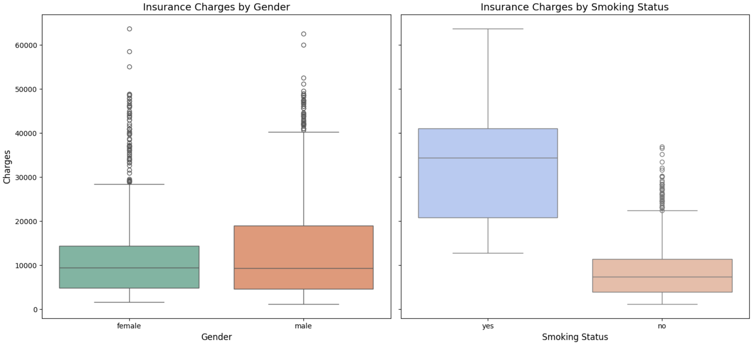
How Different Variables affect Insurance Charges
Mean
Variability Insight: Box plots show the range of charges, not just averages, helping identify variability within groups.
Outlier Detection: Easily spot high-cost outliers, which are critical for managing risk.
Provides more information by using different technique of plotting
Notes:
Before we start the analysis, imagine if you are the insurance company and you have to set optimal insurance premium for the customer.
What information would you ask your customer to decide his premium?
Age, Sex, Drinking Habits, Smoking Habits, Number of Dependents, Height, Weight, Address by that I mean which region of the city or state, type of coverage, genetic disorders
These are some good points to consider while determining insurance premium
Now lets look at our dataset.
We will not be discussing the code. The code will be usually provided to the students.
With chatgpt, coding has become very easym but you still need to understand the code so I have written comments whereever necessary.
If you have any questions in coding, please let me know
This jupyter cell will load the dataset in to the memory.
We can see that our dataset has 1338 observations and 7 columns or variables.
You mentioned several factors which could affect insurance premium but in our dataset we don’t have all of them.
This is how it would be in real life working as business analyst because not all the data we need will be given or the companies themselves don’t have it.
This process of data storing and management is called as Data Warehousing. It is a part of business analytics but comes under the branch of business intelligence.
Now assume you were insurance company employees and you had access to this dataset, what kind of descriptive analysis wold you do?
Some would say, does smoking affect insurance premium? Do women pay higher than men?
I would also want to know what is the average insurane premium charged per person?
These are some very interesting analytics, and all of them require use of more than one variable at the same time.
We will see all these analytics if we have time, but lets do some basic ones now.
Let us first answer the question, does smoking affect insurance charges,

Slide 16
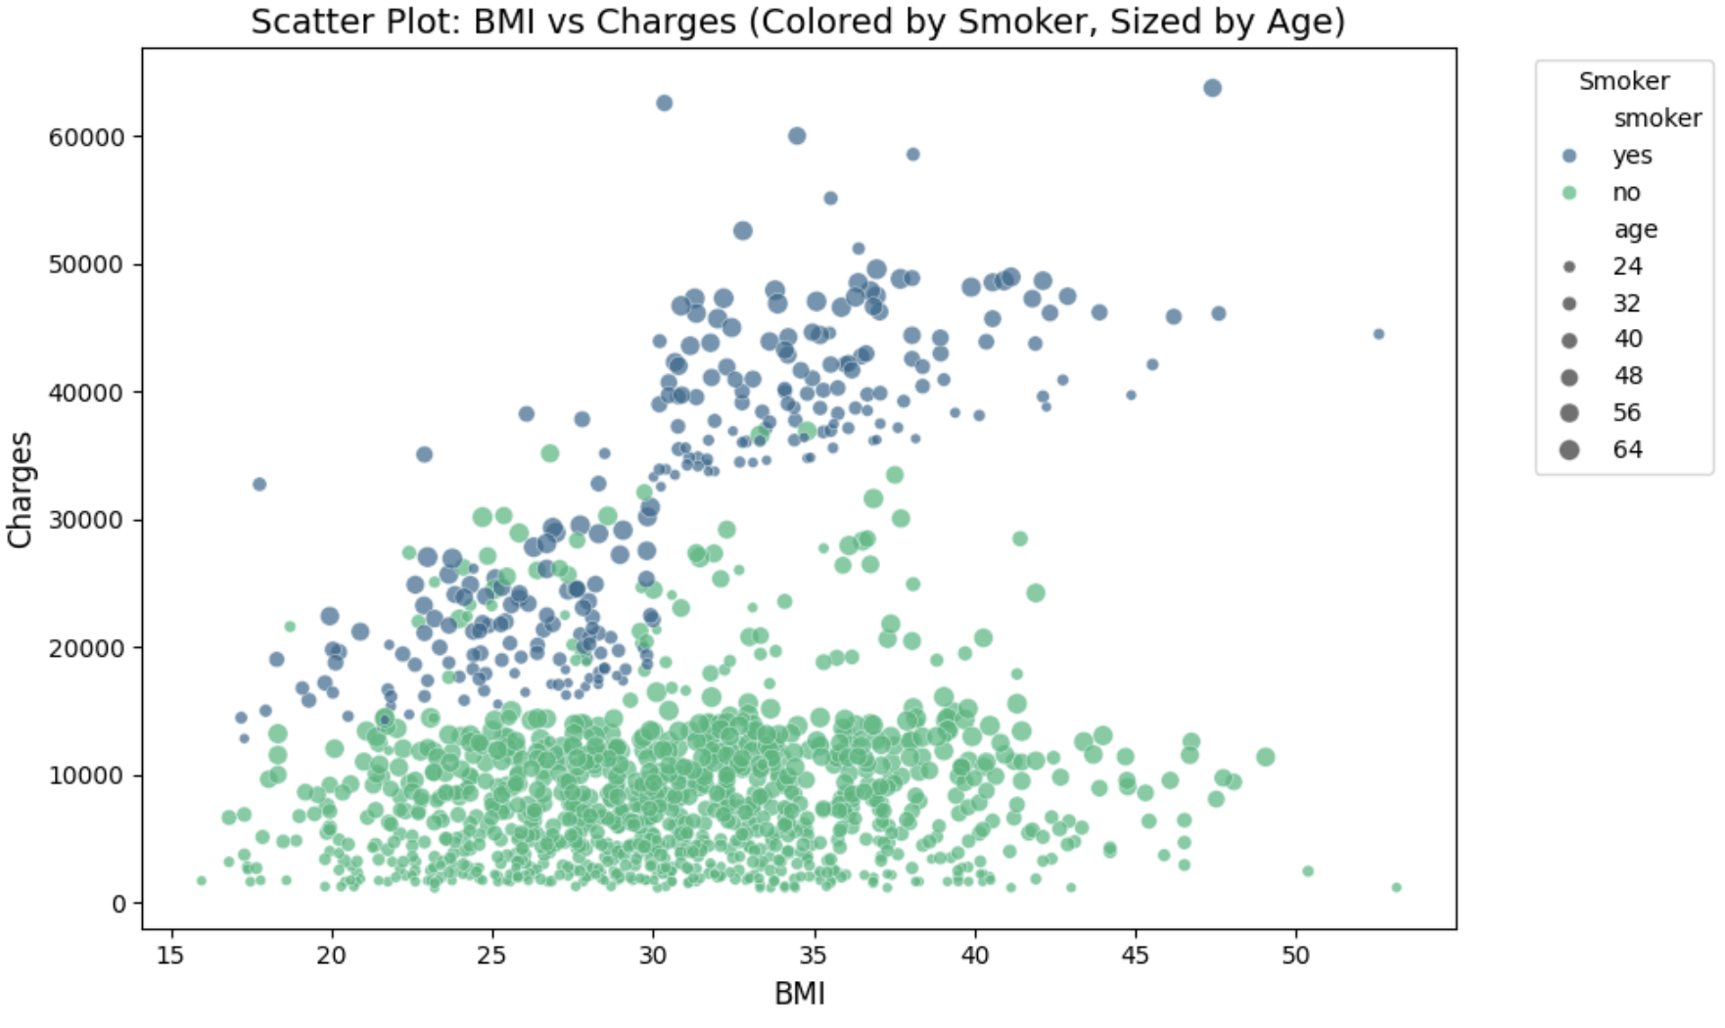
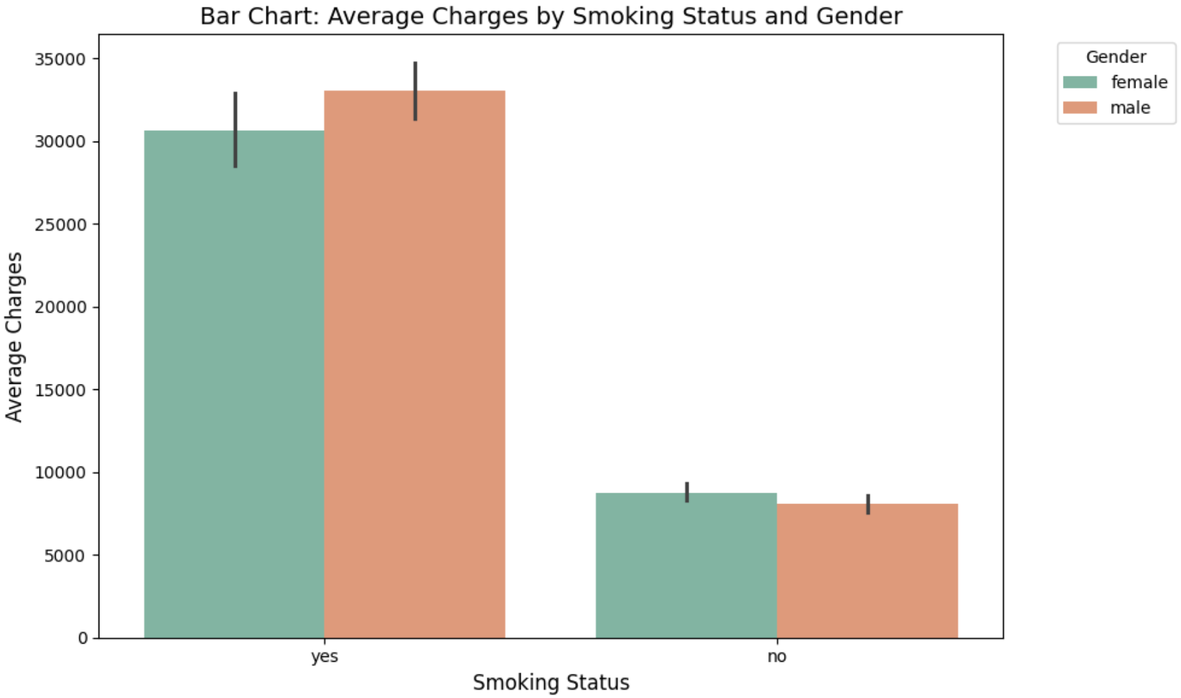
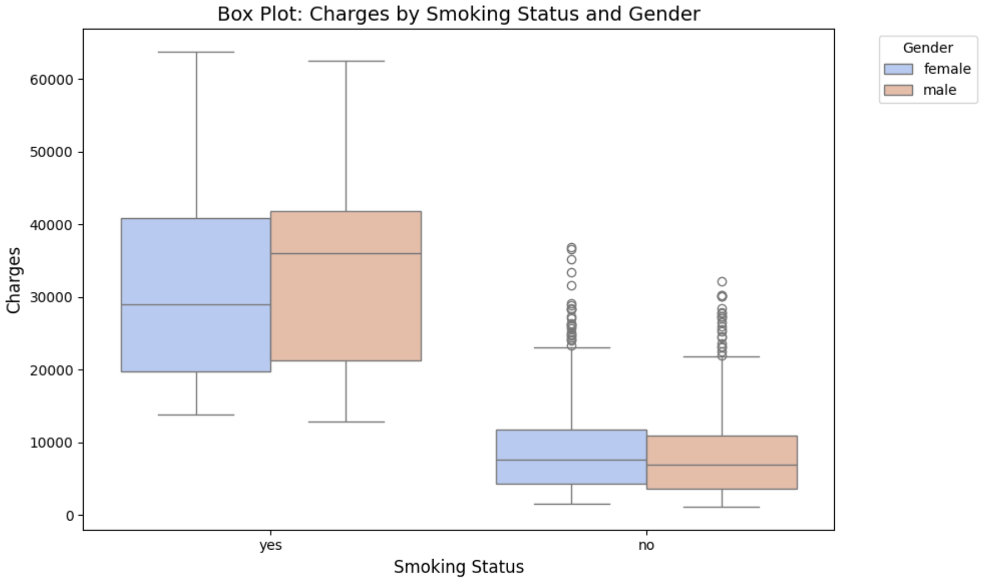
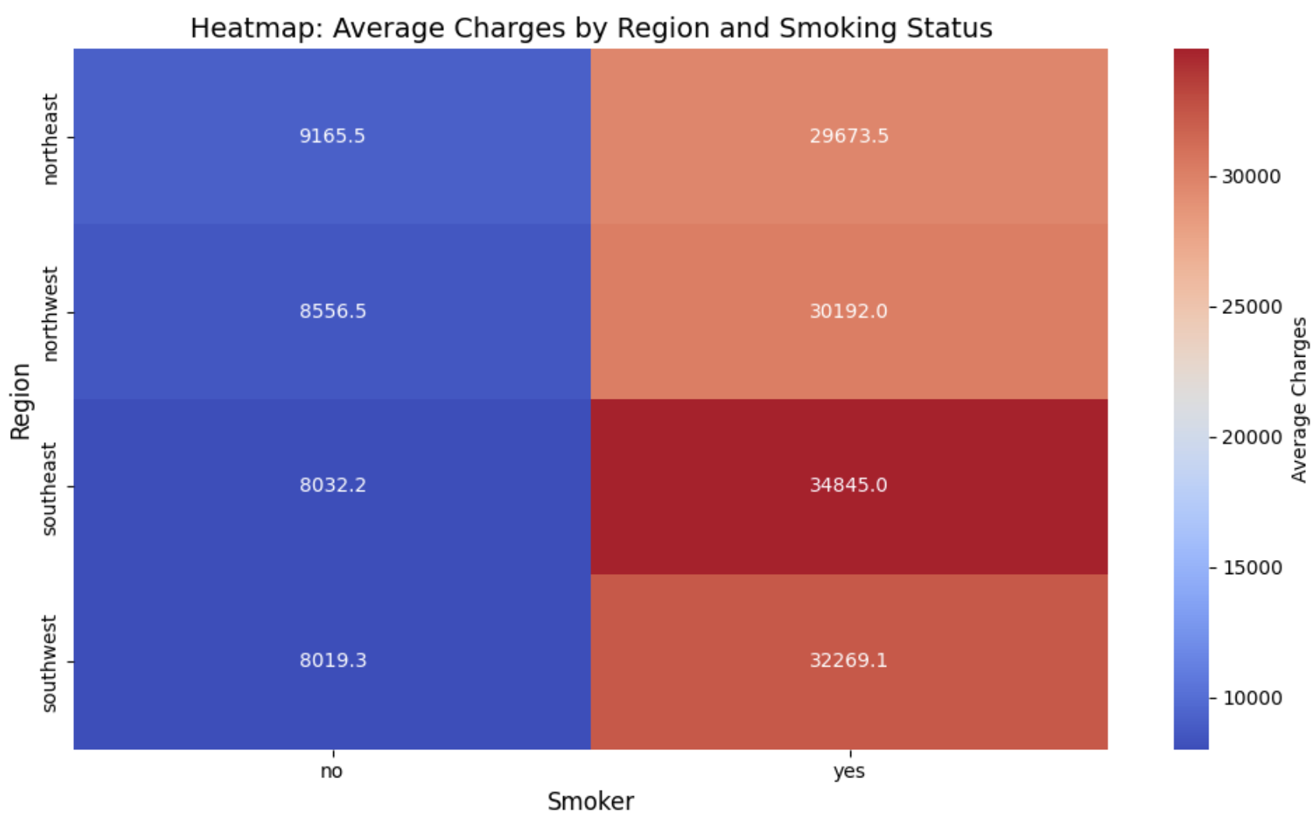
More Information on 2D plots

Slide 17
Benefits of Descriptive Analytics
Helps in monitoring performance trends
Supports Evidence based decision making
Foundation for Diagnostic, Prescriptive, Predictive Analytics
Notes:
Before we start the analysis, imagine if you are the insurance company and you have to set optimal insurance premium for the customer.
What information would you ask your customer to decide his premium?
Age, Sex, Drinking Habits, Smoking Habits, Number of Dependents, Height, Weight, Address by that I mean which region of the city or state, type of coverage

Slide 18

Short Quiz

Slide 19
Predictive Analytics
Once we know what has happened, how to predict what will happen next?
Notes:
So far we studied what is Descriptive analytics and how it can be used to study the past behaviour of different variables individually and with respect to each other.
That understanding can help us make informed decisions given familiar market conditions.
But how to prepare for the future where there is a great amount of uncertainty involved.
because No matter the field in which you work, ithere is always uncertainity involved.
So once we know what has happened, can we predict what will happen next?
Can we use past data to predict future?
This is where Predictive Analytics comes into picture.

Slide 20
What is Predictive Analytics
Based on Descriptive Analytics, how much insurance premium should the following individual pay:
Age=40, BMI=28, Sex=Male, Smoking=No, Number of children=3
Notes:
Before we start the analysis, imagine if you are the insurance company and you have to set optimal insurance premium for the customer.
How much should a insurance be for a new person who wants to join if he is of Age=40
Gender=male,
Bmi=28-30,
Some of you would say 300, some of you would say 450…
Some of you would just charge him the average.
Some would even say that if we have this exact observation in the dataset, then we can just charge him that, which is one way to do it, but unfortunately, this observation is not there in the dataset.
So how to proceed?
If we had any way to use all these variables to predict how much insurance premium should be charged, that would help us a lt
So all of these is right or wrong , we don’t know.
How to see if we are doing it correctly, wht forms the basis of our decision.
Because I told you in the hnbeginning that as a business analytics student, we need to use historical data to extract fact based business insights.
Because if you guess then what is dfference between business analyst and just using intuition..
So we need to support our answer with data.
Canwe apply a a formula which uses such vaiables and gives out put as a number which could be the insurance charged.
Such a formula is called as model.
Model will try to generate output for a given unknown observations . That is called as prediction.
You can say that model is alike a magic box which takes in iinput and gives insurance charge as output.
A model is simplistic representation of reality.
Can the model correctly predict the insurance charge?
How do you determin what is correct and what is not?
We can verify the correctness based on ground truth.
If our model correctly predicts based on the given ainformation for all the observations, then we say that our model is 100% perfect.
If our model correct predits
Provides a foundation for diagnostic, predictive, and prescriptive analytics.
Helps in monitoring performance and identifying trends.
Supports evidence-based decision-making.
Methods:
Data Visualization
Data Summary
Data Wrangling

Slide 21
What is Predictive Analytics
Based on Descriptive Analytics, how much insurance premium should the following individual pay:
Age=40, BMI=28, Sex=Male, Smoking=No, Number of children=3
Input Variables
Model
Statistics
Output Variable
Ex:
Machine Learning
Optimization
Ex:
Insurance
Age, Sex, Region
Premium
Smoking, Num of Children
Model: Insurance Premium$=f\left(Age, BMI, Sex, Smoking, Number of Children, region\right)$
Notes:
Before we start the analysis, imagine if you are the insurance company and you have to set optimal insurance premium for the customer.
How much should a insurance be for a new person who wants to join if he is of Age=40
Gender=male,
Bmi=28-30,
Some of you would say 300, some of you would say 450…
Some of you would just charge him the average.
Some would even say that if we have this exact observation in the dataset, then we can just charge him that, which is one way to do it, but unfortunately, this observation is not there in the dataset.
So how to proceed?
If we had any way to use all these variables to predict how much insurance premium should be charged, that would help us a lt
So all of these is right or wrong , we don’t know.
How to see if we are doing it correctly, wht forms the basis of our decision.
Because I told you in the hnbeginning that as a business analytics student, we need to use historical data to extract fact based business insights.
Because if you guess then what is dfference between business analyst and just using intuition..
So we need to support our answer with data.
Canwe apply a a formula which uses such vaiables and gives out put as a number which could be the insurance charged.
Such a formula is called as model.
Model will try to generate output for a given unknown observations . That is called as prediction.
You can say that model is alike a magic box which takes in iinput and gives insurance charge as output.
A model is simplistic representation of reality.
Can the model correctly predict the insurance charge?
How do you determin what is correct and what is not?
We can verify the correctness based on ground truth.
If our model correctly predicts based on the given ainformation for all the observations, then we say that our model is 100% perfect.
If our model correct predits
Provides a foundation for diagnostic, predictive, and prescriptive analytics.
Helps in monitoring performance and identifying trends.
Supports evidence-based decision-making.
Methods:
Data Visualization
Data Summary
Data Wrangling

Slide 22
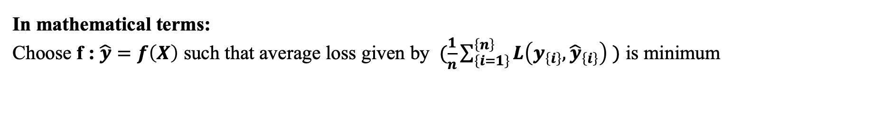
What is Predictive Analytics
Based on Descriptive Analytics, how much insurance premium should the following individual pay:
Age=40, BMI=28, Sex=Male, Smoking=No, Number of children=3
Input Variables
Model
Statistics
Output Variable
Ex:
Machine Learning
Optimization
Ex:
Insurance
Age, Sex, Region
Premium
Smoking, Num of Children
Model: Insurance Premium$=f\left(Age, BMI, Sex, Smoking, Number of Children, region\right)$
In mathematical terms:
Choose f : $\hat{y}=f\left(X\right)$ such that average loss given by $(\frac{1}{n}\sum_{\left\{i=1\right\}}^{\left\{n\right\}}{L\left(y_{\left\{i\right\}},{\hat{y}}_{\left\{i\right\}}\right) })$ is minimum
Notes:
Before we start the analysis, imagine if you are the insurance company and you have to set optimal insurance premium for the customer.
How much should a insurance be for a new person who wants to join if he is of Age=40
Gender=male,
Bmi=28-30,
Some of you would say 300, some of you would say 450…
Some of you would just charge him the average.
Some would even say that if we have this exact observation in the dataset, then we can just charge him that, which is one way to do it, but unfortunately, this observation is not there in the dataset.
So how to proceed?
If we had any way to use all these variables to predict how much insurance premium should be charged, that would help us a lt
So all of these is right or wrong , we don’t know.
How to see if we are doing it correctly, wht forms the basis of our decision.
Because I told you in the hnbeginning that as a business analytics student, we need to use historical data to extract fact based business insights.
Because if you guess then what is dfference between business analyst and just using intuition..
So we need to support our answer with data.
Canwe apply a a formula which uses such vaiables and gives out put as a number which could be the insurance charged.
Such a formula is called as model.
Model will try to generate output for a given unknown observations . That is called as prediction.
You can say that model is alike a magic box which takes in iinput and gives insurance charge as output.
A model is simplistic representation of reality.
Can the model correctly predict the insurance charge?
How do you determin what is correct and what is not?
We can verify the correctness based on ground truth.
If our model correctly predicts based on the given ainformation for all the observations, then we say that our model is 100% perfect.
If our model correct predits
Provides a foundation for diagnostic, predictive, and prescriptive analytics.
Helps in monitoring performance and identifying trends.
Supports evidence-based decision-making.
Methods:
Data Visualization
Data Summary
Data Wrangling

Slide 23
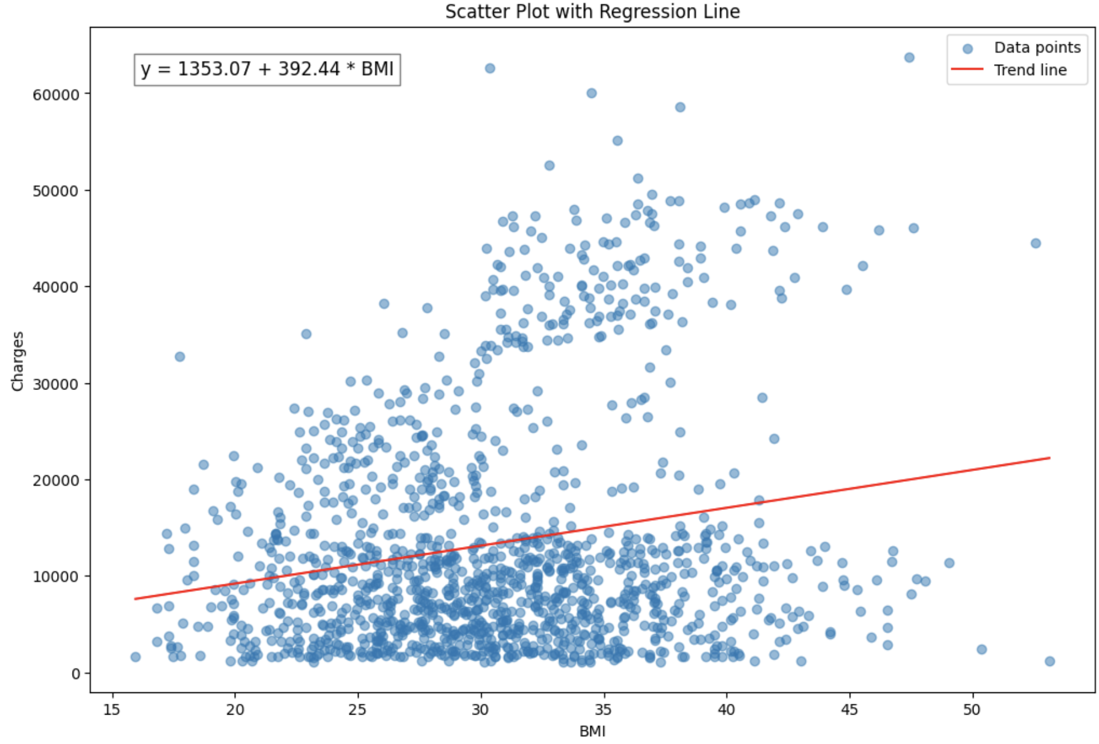
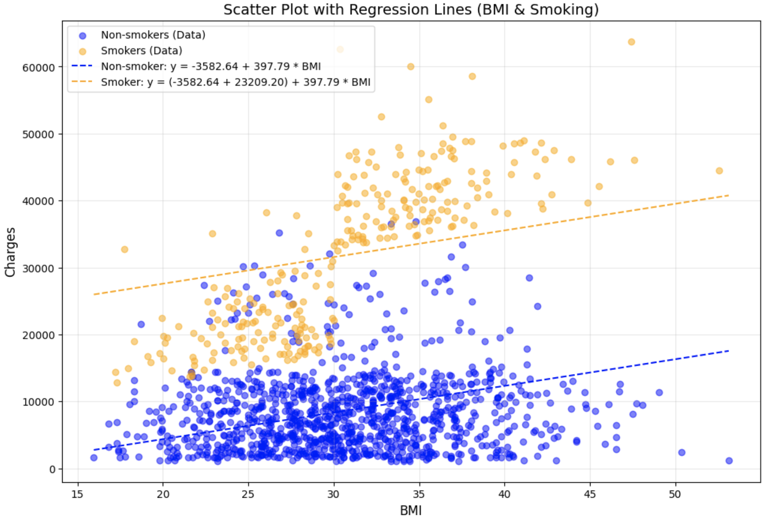
Linear Regression
Model Evaluation:
Mean Squared Error (MSE): 149085057.04
Model Evaluation:
Mean Squared Error (MSE): 47887940.86
“All models are wrong, but some are useful” – George Box
Notes:
Before we start the analysis, imagine if you are the insurance company and you have to set optimal insurance premium for the customer.
How much should a insurance be for a new person who wants to join if he is of Age=40
Gender=male,
Bmi=28-30,
Some of you would say 300, some of you would say 450…
Some of you would just charge him the average.
Some would even say that if we have this exact observation in the dataset, then we can just charge him that, which is one way to do it, but unfortunately, this observation is not there in the dataset.
So how to proceed?
If we had any way to use all these variables to predict how much insurance premium should be charged, that would help us a lt
So all of these is right or wrong , we don’t know.
How to see if we are doing it correctly, wht forms the basis of our decision.
Because I told you in the hnbeginning that as a business analytics student, we need to use historical data to extract fact based business insights.
Because if you guess then what is dfference between business analyst and just using intuition..
So we need to support our answer with data.
Canwe apply a a formula which uses such vaiables and gives out put as a number which could be the insurance charged.
Such a formula is called as model.
Model will try to generate output for a given unknown observations . That is called as prediction.
You can say that model is alike a magic box which takes in iinput and gives insurance charge as output.
A model is simplistic representation of reality.
Can the model correctly predict the insurance charge?
How do you determin what is correct and what is not?
We can verify the correctness based on ground truth.
If our model correctly predicts based on the given ainformation for all the observations, then we say that our model is 100% perfect.
If our model correct predits
Provides a foundation for diagnostic, predictive, and prescriptive analytics.
Helps in monitoring performance and identifying trends.
Supports evidence-based decision-making.
Methods:
Data Visualization
Data Summary
Data Wrangling

Slide 24
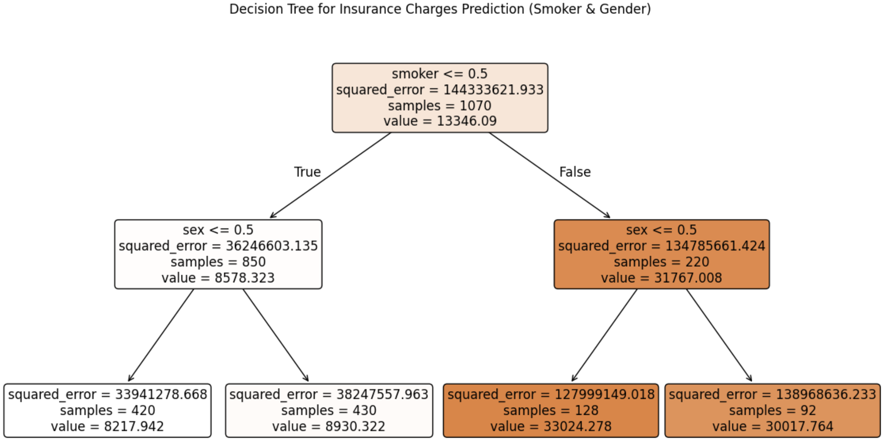
Decision Tree
Model Evaluation:
Mean Squared Error (MSE): (MSE): 53225281.16
Notes:
Before we start the analysis, imagine if you are the insurance company and you have to set optimal insurance premium for the customer.
How much should a insurance be for a new person who wants to join if he is of Age=40
Gender=male,
Bmi=28-30,
Some of you would say 300, some of you would say 450…
Some of you would just charge him the average.
Some would even say that if we have this exact observation in the dataset, then we can just charge him that, which is one way to do it, but unfortunately, this observation is not there in the dataset.
So how to proceed?
If we had any way to use all these variables to predict how much insurance premium should be charged, that would help us a lt
So all of these is right or wrong , we don’t know.
How to see if we are doing it correctly, wht forms the basis of our decision.
Because I told you in the hnbeginning that as a business analytics student, we need to use historical data to extract fact based business insights.
Because if you guess then what is dfference between business analyst and just using intuition..
So we need to support our answer with data.
Canwe apply a a formula which uses such vaiables and gives out put as a number which could be the insurance charged.
Such a formula is called as model.
Model will try to generate output for a given unknown observations . That is called as prediction.
You can say that model is alike a magic box which takes in iinput and gives insurance charge as output.
A model is simplistic representation of reality.
Can the model correctly predict the insurance charge?
How do you determin what is correct and what is not?
We can verify the correctness based on ground truth.
If our model correctly predicts based on the given ainformation for all the observations, then we say that our model is 100% perfect.
If our model correct predits
Provides a foundation for diagnostic, predictive, and prescriptive analytics.
Helps in monitoring performance and identifying trends.
Supports evidence-based decision-making.
Methods:
Data Visualization
Data Summary
Data Wrangling

Slide 25
Predictive Analytics
Benefits of Predictive Analytics
Enhanced Customer Satisfaction
Cost Optimization
Improved Decision-Making
Risk Reduction
Revenue Growth
Notes:
If we could predict the outcomes for unknown situations, we could tap potential markets and inmprove operation
Preparing for an event that has not happeed can help us tap potential markets.
This is where predictive analytics helps us.
https://online.hbs.edu/blog/post/predictive-analytics
https://www.retailbankerinternational.com/news/cba-fraud-speeds-ai/?cf-view
Start with these examples,
And that is why company use predictive analytics

Slide 26
Future of Business Analytics
Why companies and individuals should
invest time and money in Business Analytics?

Slide 27
The Growing Importance of Business Analytics
Explosive Data Growth
1.13 trillion MB of data created in 2021 — equivalent to 129,000 years of HD video
Shortage of Skilled Professionals
Companies cite a lack of analytical skills to extract insights from data
Future Job Growth
U.S. Bureau of Labor Statistics (BLS): Business Analytics jobs projected to grow by 36% in the next decade
Corporate Investments in AI and Analytics
Firms spending $50M+ on Big Data/AI: Up from 40% in 2018 to 65% in 2020
90% of all data ever created was generated in the last 2 years
Growing demand for experts to convert raw data into actionable insights
94% of businesses say analytics drives growth and transformation
Notes:
If we could predict the outcomes for unknown situations, we could tap potential markets and inmprove operation
Preparing for an event that has not happeed can help us tap potential markets.
This is where predictive analytics helps us.
https://online.hbs.edu/blog/post/predictive-analytics
https://www.retailbankerinternational.com/news/cba-fraud-speeds-ai/?cf-view

Slide 28
Thank you
Questions?
My email id: nikhil.narayane99@gmail.com
My personal website: www.nikhil9.in
My Youtube channel:
nikhilstat
Notes:
If we could predict the outcomes for unknown situations, we could tap potential markets and inmprove operation
Preparing for an event that has not happeed can help us tap potential markets.
This is where predictive analytics helps us.
https://online.hbs.edu/blog/post/predictive-analytics
https://www.retailbankerinternational.com/news/cba-fraud-speeds-ai/?cf-view
Start with these examples,
And that is why company use predictive analytics

